Slide 1
Mondelez Case Study
BY HIMANSHU CHOPRA

Slide 2
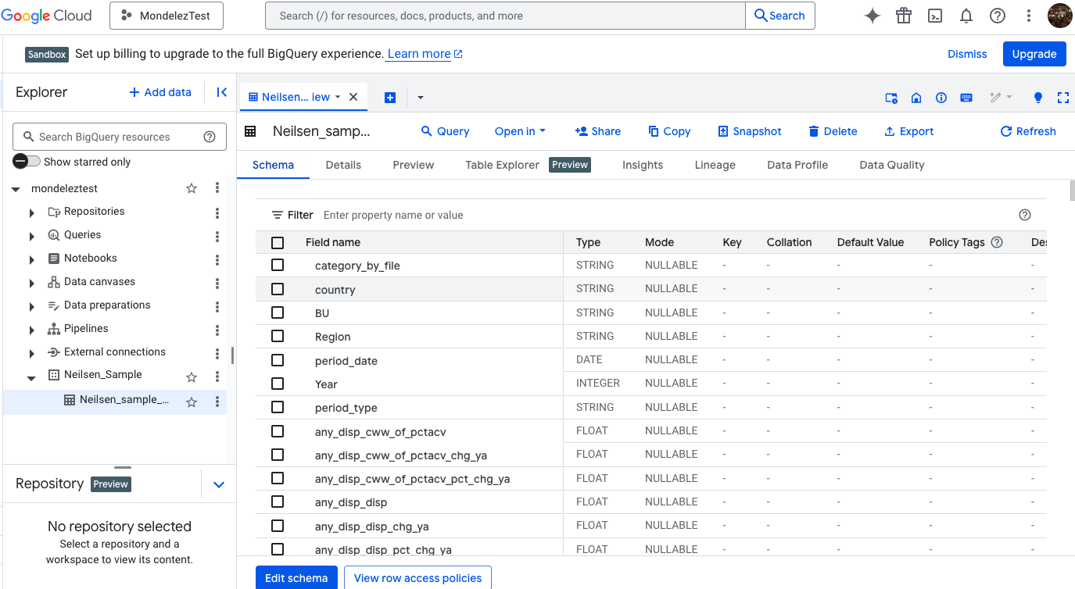
I have created a demo workspace in BigQuery to perform all the SQL tasks.
Here, I have created a Mondelez Test Project under which I have created A new Dataset known as Neilsen_Sample and exported the data given in the xlsx file in the email. Share is dollar or unit divided by total
CAGR = Compounded Annual Growth Rate

Slide 3
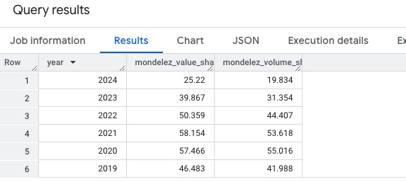
Q1:What is share of Mondelez manufacturer (mi_key_mfr) in mega-category of biscuits over the years? Please show value and volume. (46% to 25% Sale_share)
SELECT
m.year,
round(((m.mondelez_sales_value / t.total_biscuit_sales_value) * 100),3) AS mondelez_value_share,
round(((m.mondelez_sales_volume / t.total_biscuit_sales_volume) * 100),3) AS mondelez_volume_share
FROM mondelez_sales m
JOIN total_sales t
ON m.year = t.year
ORDER BY m.year DESC;
WITH total_sales AS (
SELECT
year,
SUM(dollar) AS total_biscuit_sales_value,
SUM(units) AS total_biscuit_sales_volume
FROM `mondeleztest.Neilsen_Sample.Neilsen_sample_Interview`
WHERE mi_mega_category = 'BISCUITS'
GROUP BY year
),
mondelez_sales AS (
SELECT
year,
SUM(dollar) AS mondelez_sales_value,
SUM(units) AS mondelez_sales_volume
FROM `mondeleztest.Neilsen_Sample.Neilsen_sample_Interview`
WHERE mi_key_mfr = 'MONDELEZ'
AND mi_mega_category = 'BISCUITS'
GROUP BY year
)

Slide 4
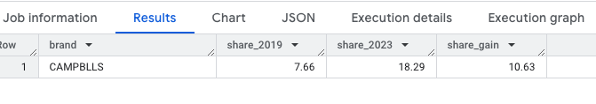
Q2: Which brand has gained the most shares from 2019 to 2023?
Ans: CAMPBLLS has gained the most share, with an increase of 10.63% from 2019 to 2023
brand_share as (
select
mt.year,
mt.brand,
round(mt.total_sales_value,2) mfr_sales,
round(tov.total_sales_value,2) total_Sales,
round((mt.total_sales_value/tov.total_sales_value * 100),2) as share_contribution
from totals_overall tov
left join manufactures_totals mt on mt.year= tov.year
where mt.total_sales_value >0 and tov.total_sales_value>0
order by year asc, 5 desc )
SELECT
brand,
MAX(CASE WHEN year = 2019 THEN share_contribution END) AS share_2019,
MAX(CASE WHEN year = 2023 THEN share_contribution END) AS share_2023,
ROUND(
MAX(CASE WHEN year = 2023 THEN share_contribution END) - MAX(CASE WHEN year = 2019 THEN share_contribution END), 2
) AS share_gain
FROM brand_share
GROUP BY brand
order by 4 desc
limit 1;
with manufactures_totals as
(SELECT
year,
mi_key_mfr as brand,
SUM(dollar) AS total_sales_value,
SUM(units) AS totals_sales_volume,
FROM `mondeleztest.Neilsen_Sample.Neilsen_sample_Interview`
WHERE mi_mega_category = 'BISCUITS'
and year between 2019 and 2023
GROUP BY year, mi_key_mfr
ORDER BY 3 DESC ),
totals_overall as
(
SELECT
year,
SUM(dollar) AS total_sales_value,
SUM(units) AS totals_sales_volume,
FROM `mondeleztest.Neilsen_Sample.Neilsen_sample_Interview`
WHERE mi_mega_category = 'BISCUITS'
and year between 2019 and 2023
GROUP BY year
ORDER BY 3 DESC ),

Slide 5
Q3:In which sub-category is the share of Mondelez under-indexed (less than) vs the total mega-category of biscuits? As the year is not mentioned in the question, we are doing the calculation without considering the year.
SELECT
s.sub_category,
ROUND((s.mondelez_sales / NULLIF(s.total_sales_value, 0)) * 100, 2) AS mondelez_sub_category_share,
ROUND((t.mondelez_sales / NULLIF(t.total_sales_value, 0)) * 100, 2) AS mondelez_total_share
FROM sub_category_sales s
CROSS JOIN total_biscuits_sales t
WHERE (s.mondelez_sales / NULLIF(s.total_sales_value, 0)) < (t.mondelez_sales / NULLIF(t.total_sales_value, 0))
ORDER BY mondelez_sub_category_share ASC;
WITH sub_category_sales AS (
SELECT
mi_subcategory AS sub_category,
SUM(dollar) AS total_sales_value,
SUM(CASE WHEN mi_key_mfr = 'MONDELEZ' THEN dollar ELSE 0 END) AS mondelez_sales
FROM `mondeleztest.Neilsen_Sample.Neilsen_sample_Interview`
WHERE mi_mega_category = 'BISCUITS'
GROUP BY mi_subcategory
),
total_biscuits_sales AS (
SELECT
SUM(dollar) AS total_sales_value,
SUM(CASE WHEN mi_key_mfr = 'MONDELEZ' THEN dollar ELSE 0 END) AS mondelez_sales
FROM `mondeleztest.Neilsen_Sample.Neilsen_sample_Interview`
WHERE mi_mega_category = 'BISCUITS'
)

Slide 6
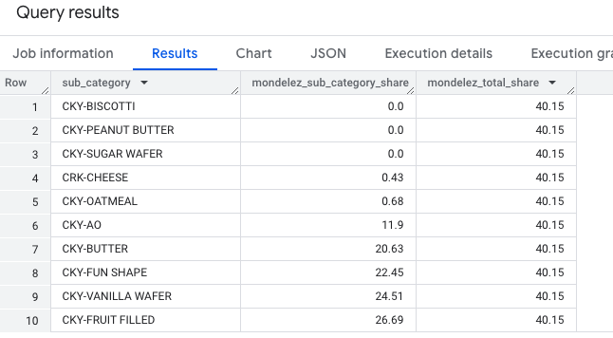
Q3 Results:
As we can see, all these 10 sub-categories are the ones where the share of Mondelez is under-indexed than the total mega-category of biscuits.

Slide 7
Q4: Show pack size segment (mi_pack) with the CAGR increase from 2019 to 2023? SQL also
CAGR= (Value_end /Value_Start)^{(1/n)} - 1
Value_end = Final value (e.g., sales in 2023)
Value_start = Initial value (e.g., sales in 2019)
n = Number of years (e.g., 2023−2019)= 4
We can use pow(Power) function in BQ to achieve CAGR.
PARTY SIZE and SINGLE SERVE show strong positive CAGRs (106.52% and 82.55%), indicating they have experienced significant growth in sales over the 4 years.
FAMILY SIZE and BASE SIZE also have a good CAGR of around 39% to 31%, suggesting steady and strong growth.
WITH sales AS ( SELECT mi_pack, Year, coalesce(SUM(dollar),0) AS total_sales FROM `mondeleztest.Neilsen_Sample.Neilsen_sample_Interview` m WHERE year IN (2019, 2023) GROUP BY mi_pack, year ORDER BY year asc
),
pivot_form AS ( SELECT mi_pack, coalesce (MAX(CASE WHEN year = 2019 THEN total_sales END),0) AS sales_2019, coalesce (MAX(CASE WHEN year = 2023 THEN total_sales END),0) AS sales_2023 FROM sales GROUP BY mi_pack )
SELECT mi_pack, round(sales_2019,2) sales_2019, round(sales_2023,2) sales_2023,
coalesce (ROUND( (POW(sales_2023 / NULLIF(sales_2019, 0),0.25) - 1) * 100, 2),0) AS CAGR_Percentage
FROM pivot_form ORDER BY CAGR_Percentage DESC;

Slide 8
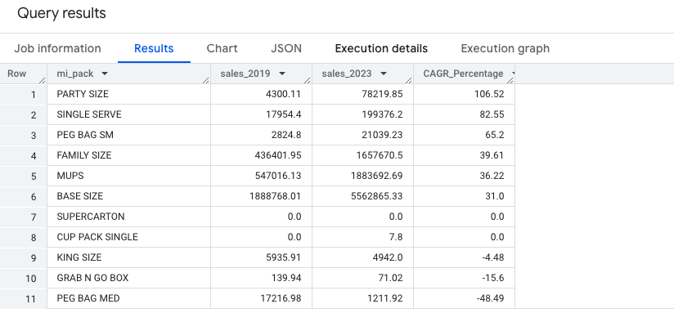
Q4 Results

Slide 9
Q5: Which brand has seen the largest growth /decline from 2019 to 2023?
NABISCO (NABISCO BISCUIT CO) has seen the largest growth in th sales_Change which is approx 2.14M and Take”s Bake shop has seen the largest decline which is approx -20,854.
with total_sales as (
SELECT
year,
m.brand_high as brand,
SUM(dollar) AS total_sales_value,
FROM `mondeleztest.Neilsen_Sample.Neilsen_sample_Interview` m
WHERE year <2024
and mi_key_mfr = 'MONDELEZ'
GROUP BY year, m.brand_high
ORDER BY 1 DESC, 3 desc
)
SELECT
brand,
COALESCE(MAX(CASE WHEN year = 2019 THEN total_sales_value END), 0) AS sales_2019,
COALESCE(MAX(CASE WHEN year = 2023 THEN total_sales_value END), 0) AS sales_2023,
ROUND(
COALESCE(MAX(CASE WHEN year = 2023 THEN total_sales_value END), 0) -
COALESCE(MAX(CASE WHEN year = 2019 THEN total_sales_value END), 0), 2
) AS sales_change
FROM total_sales
GROUP BY brand
ORDER BY sales_change DESC;

Slide 10
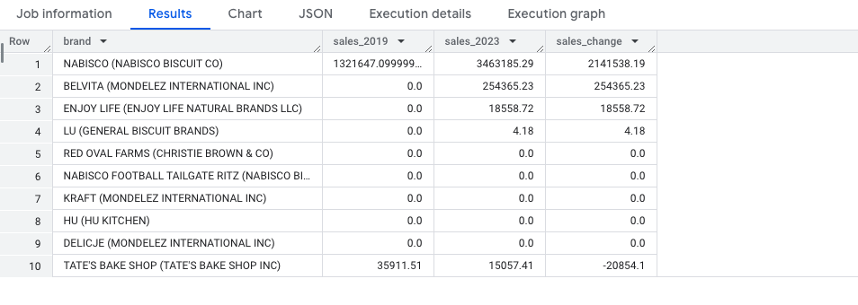
Q5 Results:

Slide 11
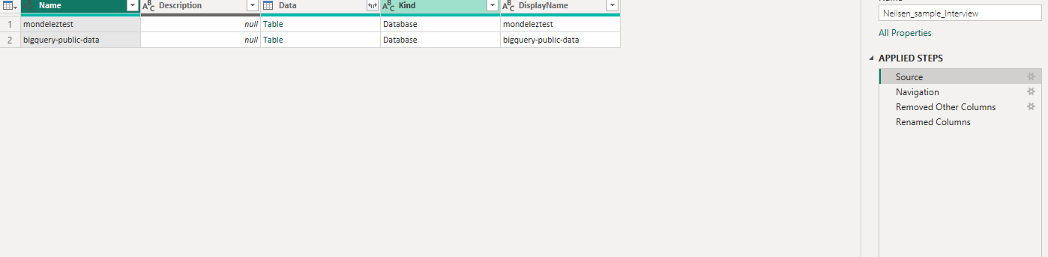
Power BI Questions:
For the Power BI questions, the dataset is connected to GoogleBigQuery Using the GetData option. The billing account/project is used in our case that is mondeleztest to have real-time or live connection from BigQuery to Power BI using DirectQuery. A Screenshot has been attached that shows the connection.

Slide 12
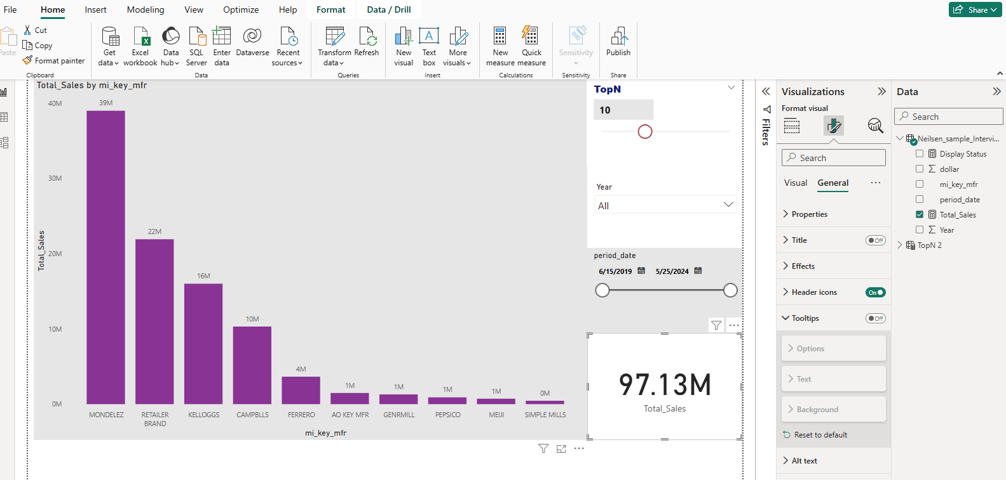
Q1:Power BI : Plot a column chart to show top N manufacturers by dollars with time period filters: Here, TOPN is dynamic.

Slide 13
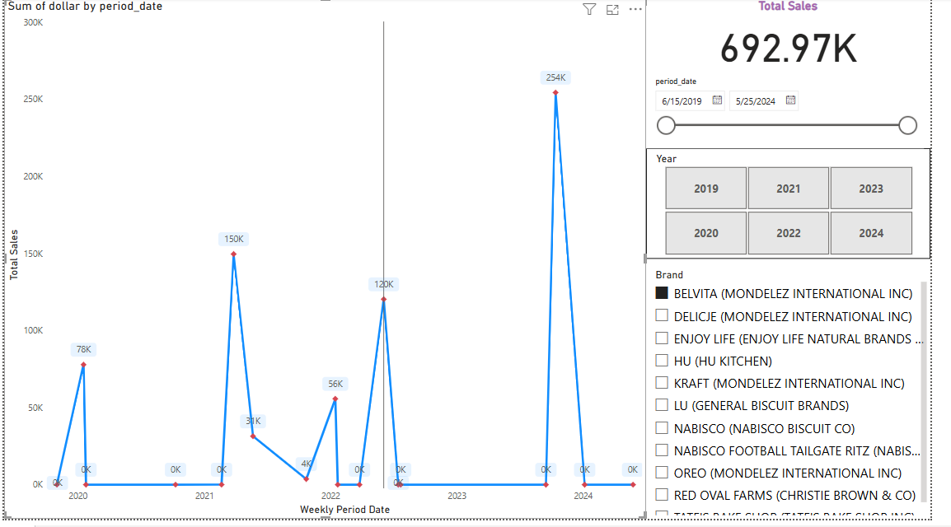
Q: Plot a weekly sales trend chart for Mondelez manufacture and brand filters. Ans: We have year as a filter, period_date as a filter, Brand as a filter and showing total Sales by the brand weekly and cumulative on top.

Slide 14
THANK YOU.

